Slide 1
NYC Taxi Demand Prediction and Price Forecasting
BIA-678
Prof. Venu Guntupalli
TEAM D
Harshit Kumar
Kushal Doshi
Pavan Kumar Kotapally
Preeti Reddy Koppolu

Slide 2
Table Of Contents
Background
Problem Statement & Objective
Methodology
Data Collection
Data Preparation
Data Joining
Feature Engineering
Data Cleaning
Outliers
Exploratory Data Analysis
Data Modelling
Demand Prediction
Scaling
Price Forecasting
Scaling
Deployment

Slide 3



Background
Price prediction has always been popular since the time when ride sharing apps were launched.
Every app claims to have the lowest price compared to its competitors.
So how are they able to do it?
With the increasing amount of data everyday, algorithms can be developed in such a way that the customers can get the lowest and the most accurate price.

Slide 4
Problem Statement & Objective
OBJECTIVE: The objective of this project is to develop a Demand and Price forecasting model using the NYC taxi dataset. Our aim is to accurately forecast the demand for taxi services in various locations and predict the corresponding pricing, taking into consideration the weather conditions in New York City. The insights and predictions generated by this model will facilitate efficient resource allocation, improve service availability, and optimize pricing strategies for taxi operators in the NYC area.
PROBLEM STATEMENT: Develop a predictive model that utilizes historical and real-time NYC taxi dataset information to address the following specific problems:
Demand Prediction: Predict the future demand for taxi services in different neighborhoods and time intervals within New York City. This involves identifying high-demand areas, understanding weather patterns, and forecasting passenger requests accurately.
Price Prediction: Predict taxi pricing based on demand, location, time of day, and other relevant factors. This includes determining optimal pricing strategies to ensure fair fares for passengers.

Slide 5
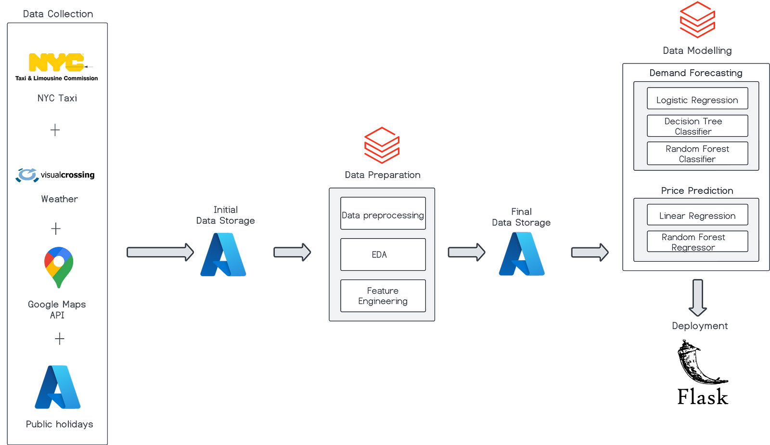
Methodology

Slide 6
Dataset Collection
Main Dataset : TLC Taxi Data
Source: TLC Website (Taxi & limousine Commission)
Coverage: 2021 Jan to 2022 December
Size: 70 million rows
Additional Dataset 1: Weather Data
Source: Visual Crossing API
Coverage: Hourly Data for years 2021 and 2022
Additional Dataset 2: NYC Holiday Data
Source: Azure Open Datasets
Coverage: 2021 Jan to 2022 December
Additional Dataset 3: Location Coordinates
Source: Google Maps API

Slide 7
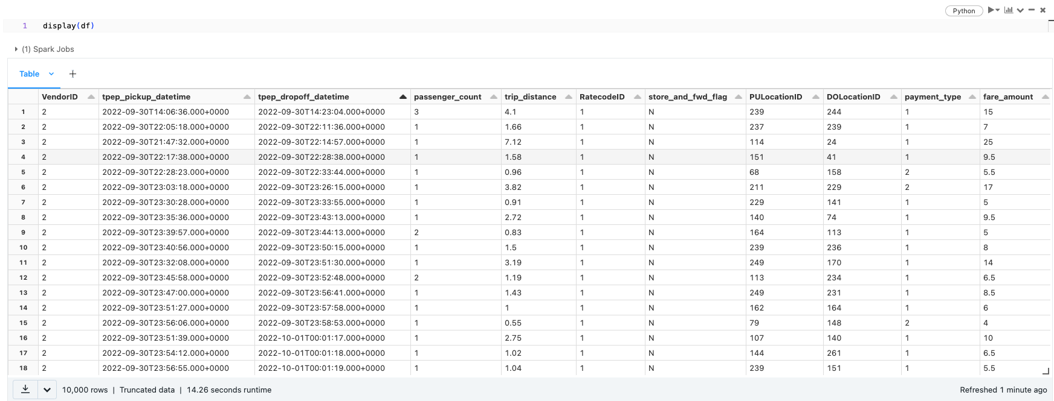
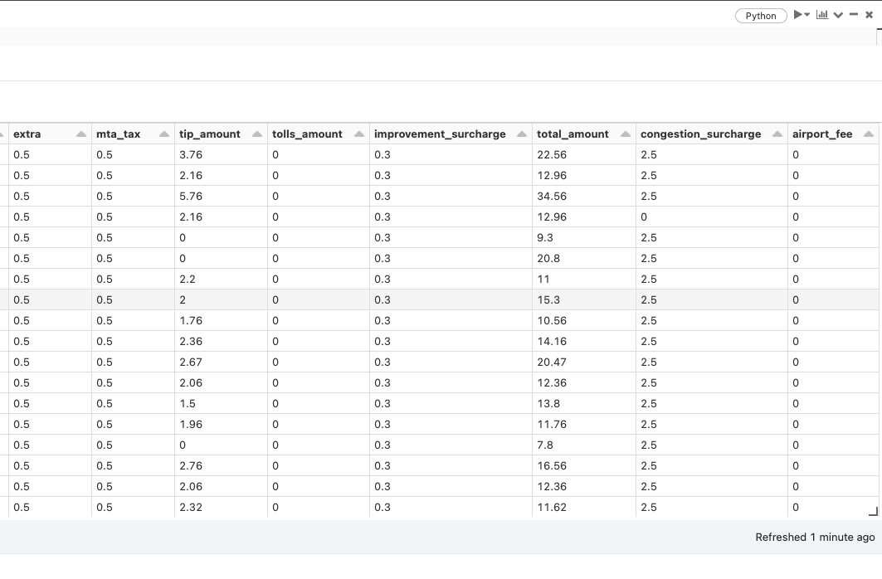
Dataset Collection
Taxi Dataset

Slide 8
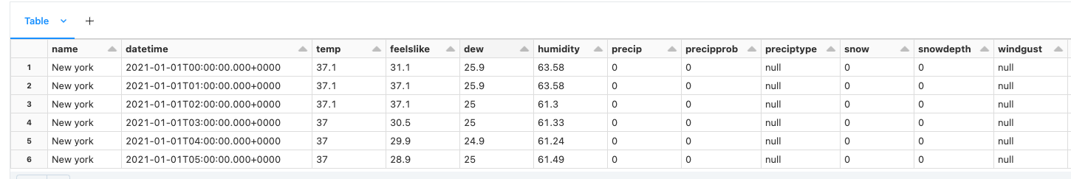
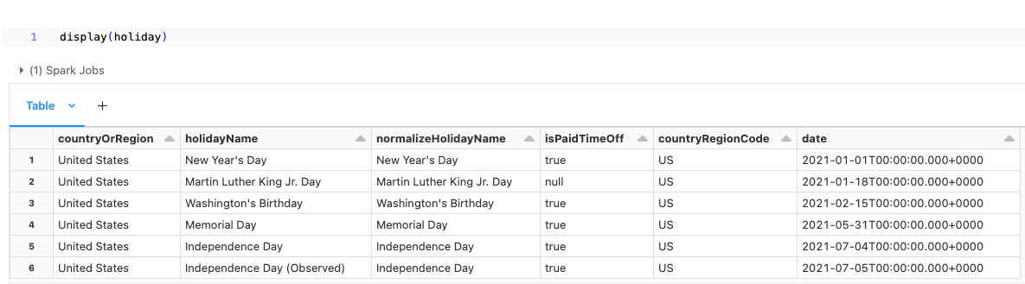
Dataset Collection
Weather Dataset
Holiday Dataset

Slide 9
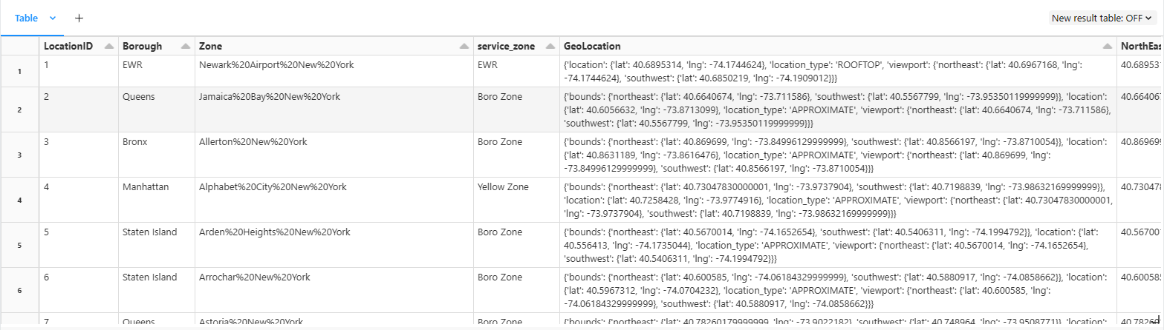
Dataset Collection
Location Coordinates

Slide 10
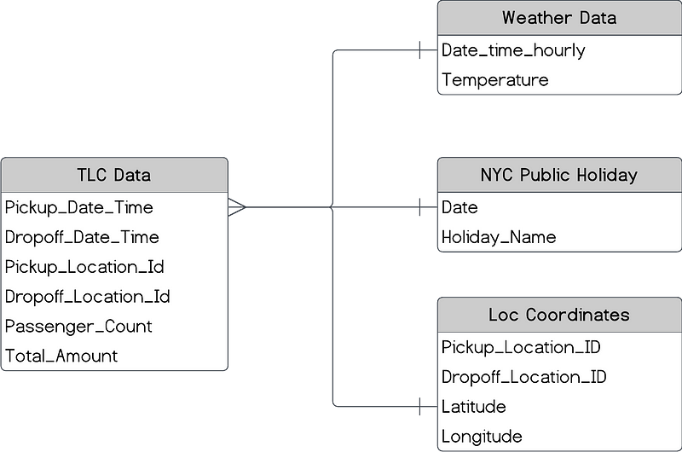
Dataset - ER Diagram

Slide 11
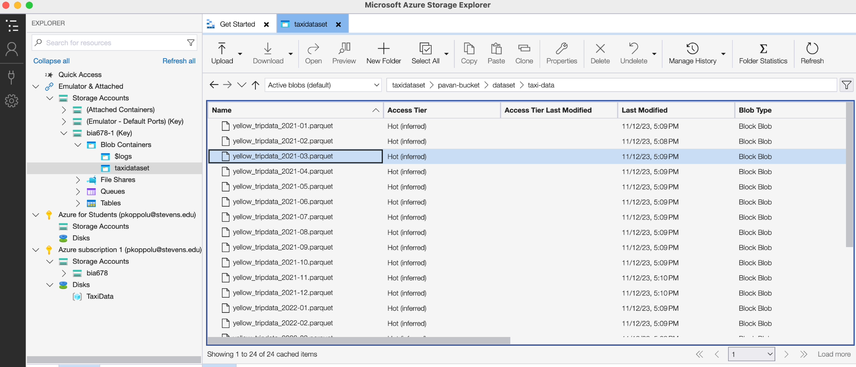

Data Storage
The data collected from all the sources was initially stored in Azure Blob Storage, ensuring accessibility for further stages.

Slide 12
Data Preparation
Data Joining
For joining the datasets, hourly time bins were created in the main trip records dataset.
The weather and holiday datasets are then joined with the main dataset in these time bins.
The location dataset was joined to the main dataset on pickup location ID and drop-off location ID.

Slide 13
Data Preparation
Feature Engineering
“is_holiday” :
This feature was created using the day of the week function and New York's holiday calendar.
Categorizes days as regular weekdays (0) or weekends/public holidays in New York (1).
It's used to distinguish demand patterns on holidays/weekends from typical weekdays.
“trip_duration”:
Calculated by subtracting the Unix timestamp of “pickup_datetime” from “dropoff_datetime”.
The trip_duration feature measures the length of taxi trips in minutes.
Helps in analyzing trip lengths which is essential for price prediction models.
“speed_mph”
It's computed by dividing trip_duration (in minutes) by 60 to convert it to hours, thus providing the average trip speed
The speed_mph feature in our dataset indicates the average speed of each taxi trip in miles per hour.
This feature is key for incorporating traffic conditions into our model analysis.

Slide 14
Data Preparation
Feature Engineering
“no_of_pickups” :
This feature was created by grouping by “time_bins” and “PULocationID” and counting number of trip records for each group formed.
It gives us information about the total number of trips booked at each location in every hour of the time period considered.
This is used to understand the demand for taxis in New York City divisions.
“demand_category”:
This categorical variable was created by splitting “no_of_pickups” into 3 quartiles and assigned low, medium and high demand categories to each of the quartiles.
This classification provides a clear, tiered understanding of taxi demand, enhancing our predictive model's ability to forecast demand under varying conditions and times.
“demand_category_squared”
It was created by squaring “demand_category”.
This feature amplifies the categorization of taxi demand and captures degree of variance within each category.

Slide 15
Data Preparation
Data Cleaning
Splitting Date time to different Columns
Date time was splitted into “year”, ”month”, “day”, “hour”, “minute”
Removing Tip Amount and Adding Congestion surcharge and airport fee to the total amount
Tip amount was removed as did not add any significance to the price
Congestion surcharge and airport fee was added as per the pickup and drop locations
Dropping unnecessary columns from the data
Columns such as "tip_amount", "fare_amount", 'extra', 'mta_tax', 'tolls_amount', 'improvement_surcharge', 'congestion_surcharge', "airport_fee", "RatecodeID", "store_and_fwd_flag", "LocationID" were removed as either they were merged into one or were not adding any significance

Slide 16
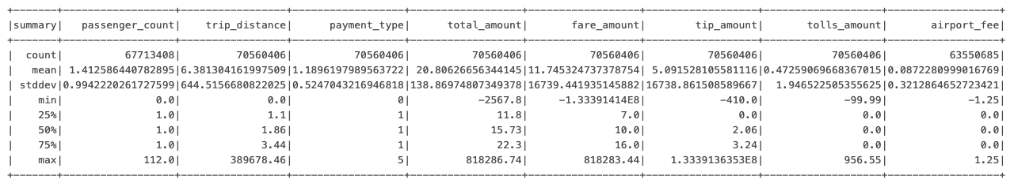
Exploratory Data Analysis
Here is a summary of the initial TLC taxi-dataset (without cleaning)
ddf
Observations:
The passenger count and trip distance is zero for some of the records.
The total amount comprising of the fare amount, tip, airport fee and tolls is negative for some of the trips.
The trip distance and all amounts has skewed data.

Slide 17
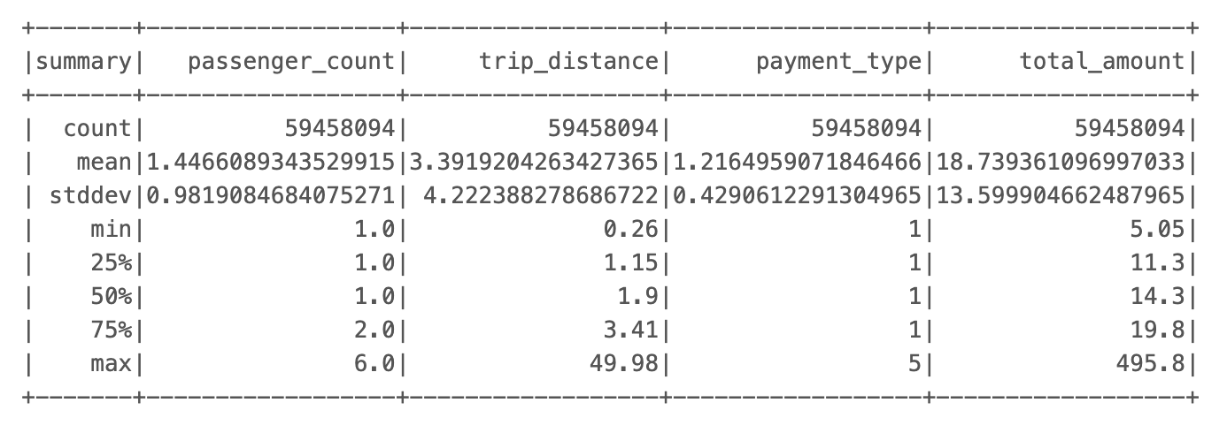
Exploratory Data Analysis
Here is a summary of the initial TLC taxi-dataset (after cleaning)
Observations:
The passenger count and trip distance reflects the right values for min and max.
The total amount comprising of the fare amount, tip, airport fee and tolls is non-negative for all of the trips.
The skewness for the trip distance and total amount is also corrected.

Slide 18
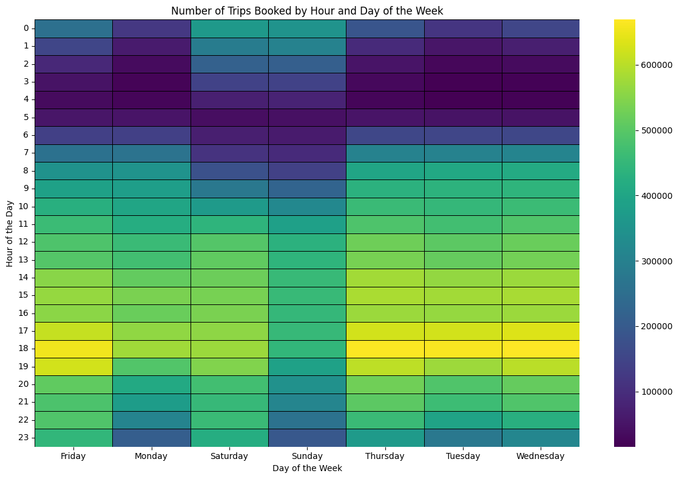
Exploratory Data Analysis
Observations:
The heatmap shows the number of trips booked for the period of 2 years starting from Jan 2021 and Dec 2022
The highest number of bookings are made in the evening around 6 PM.
The number of trips distribution is similar for most of the days for the week.

Slide 19
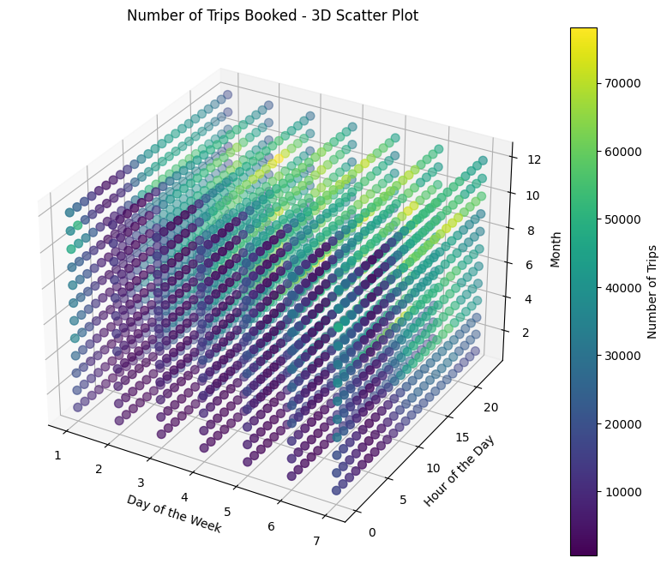
Exploratory Data Analysis
Observations:
The 3D Scatter plot shows the number of trips booked for the period of 2 years starting from Jan 2021 and Dec 2022 by month, day of the week and hour.
The highest number of bookings are made in later months of the year, like October, November and December.

Slide 20
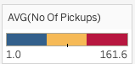
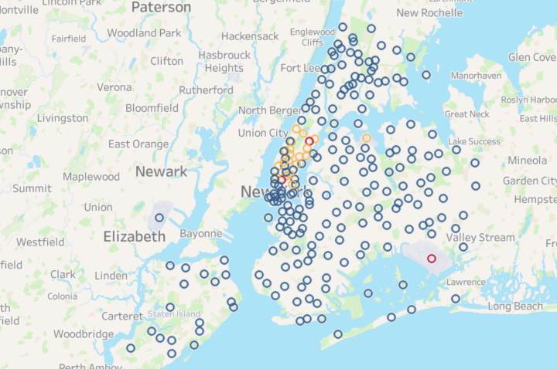
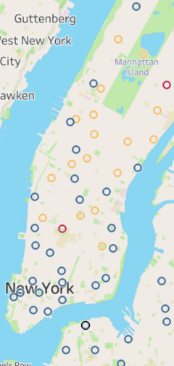
Exploratory Data Analysis

Slide 21
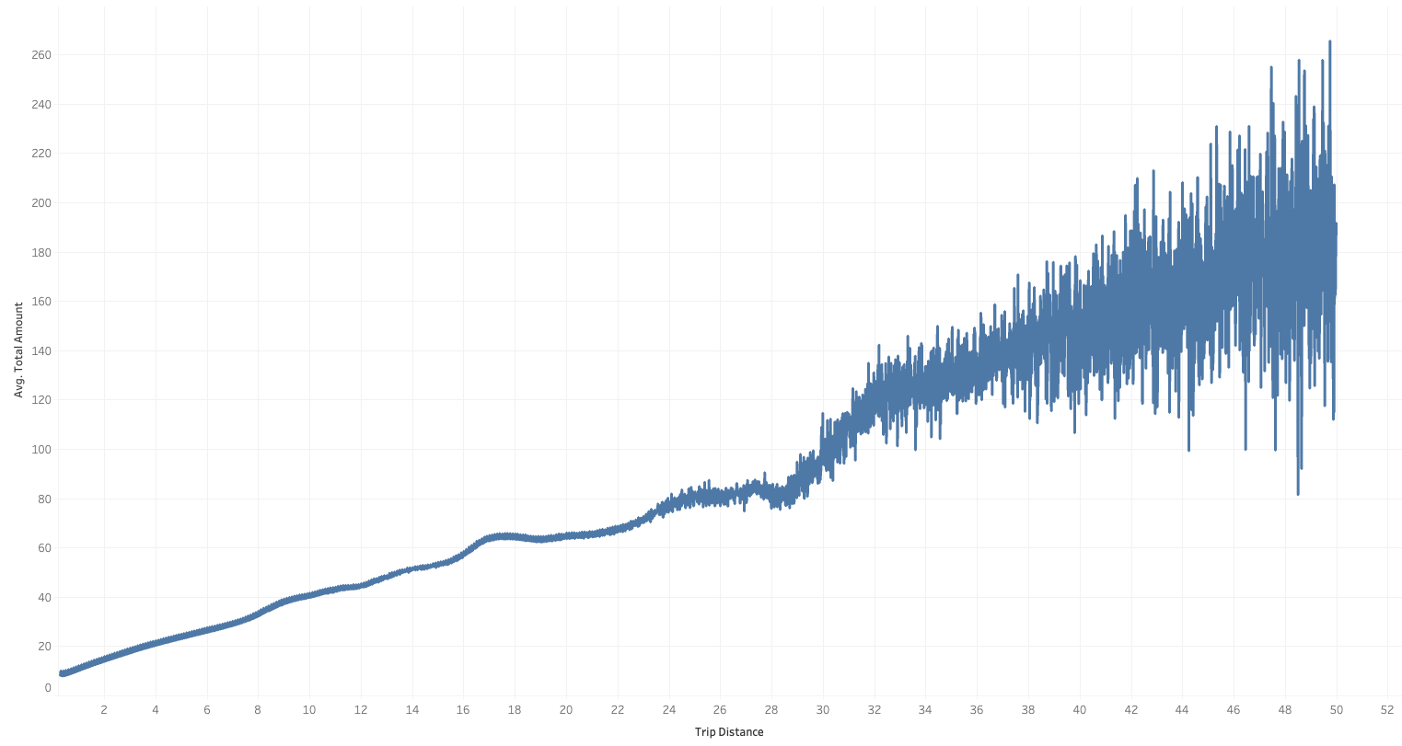
Exploratory Data Analysis
Observations:
Here is a line plot showing the direct relationship between the Trip Distance and the Average Ride fare.
There are quite a few spikes which indicate higher prices for hot spot destinations including Airport, restaurants, etc.

Slide 22
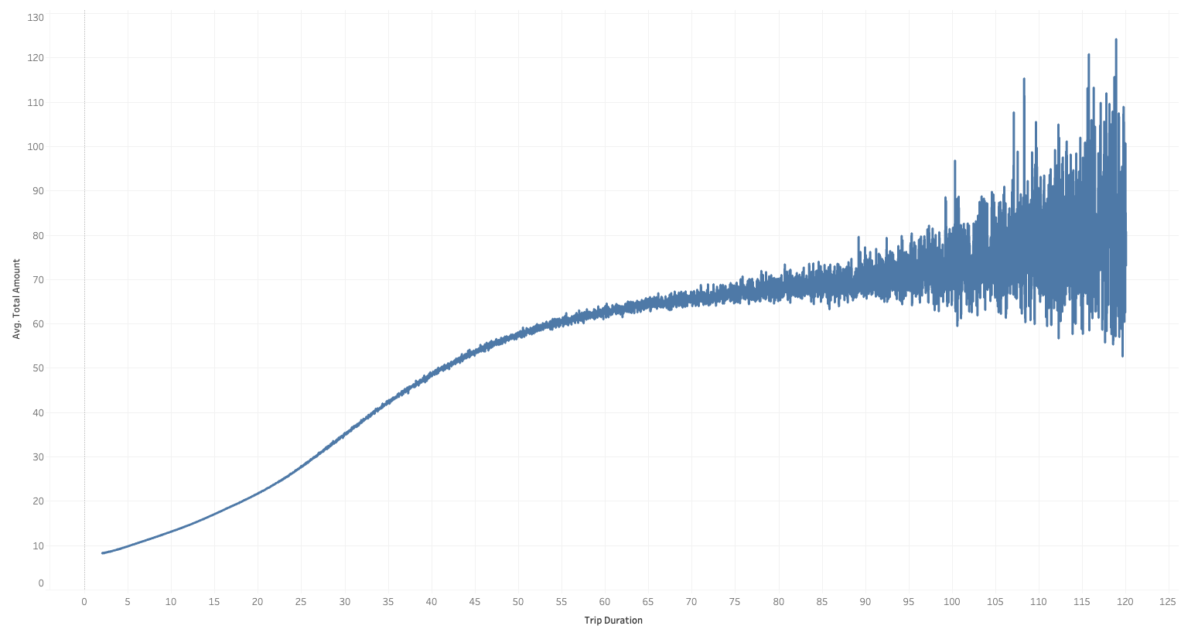
Exploratory Data Analysis
Observations:
Here is a line plot showing the direct relationship between the Trip Duration and the Average Ride fare.
There are quite a few spikes which tell about the price surge due to higher traffic, bad weather, etc.
10358738@compassassociate.com

Slide 23
Data Preparation
Removing the Outliers
Criteria | Description
Fare Range | Total fares between $5 and $500
Trip Duration (min) | Between 2 to 300 minutes
Trip Distance (miles) | From 0.25 to 50 miles
Year | From 2021 to 2022
Passenger Count | 1 to 6 passengers
Speed Limit (mph) | 55 mph or less
Number of pickups | 200 or Less

Slide 24


Data Modelling
We developed two distinct but interconnected predictive models
Demand Prediction
Classification
Price Forecasting
Regression

Slide 25
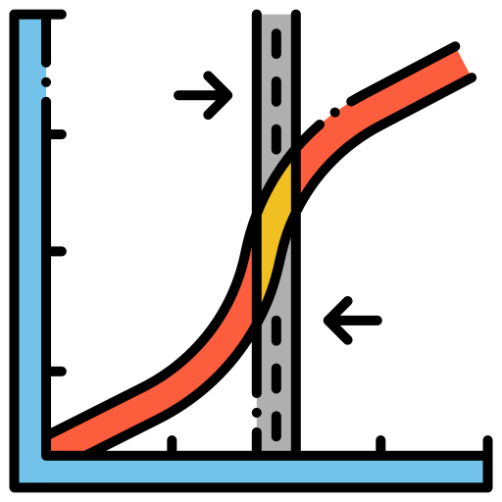


Demand Prediction
Main objective is to classify demand at every location in New York City.
Features:
Year
Month
Day
Hour
Temperature
Pickup Location Latitude
Pickup Location Longitude
Target:
Demand Category
Models
Logistic Regression
Random Forest
Decision Tree

Slide 26
Model Evaluation
Model | Accuracy
Logistic Regression | 0.452
Decision Tree Classifier | 0.726
Random Forest Classifier | 0.722
Hyperparameter tuning was conducted for decision tree classifier and random forest classifier.
Model | Decision Tree Classifier
maxBins | 64
maxDepth | 10
minInstancesPerNode | 5
Accuracy | 0.82
Model | Random Forest Classifier
numTrees | 20
maxDepth | 10
Accuracy | 0.794

Slide 27
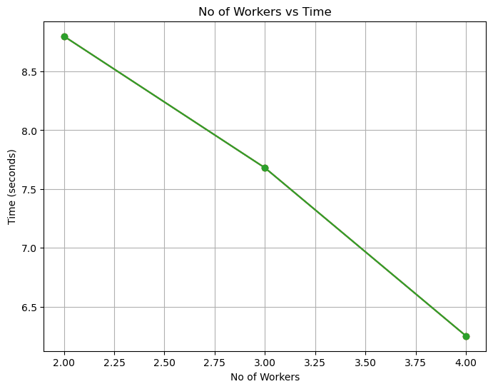
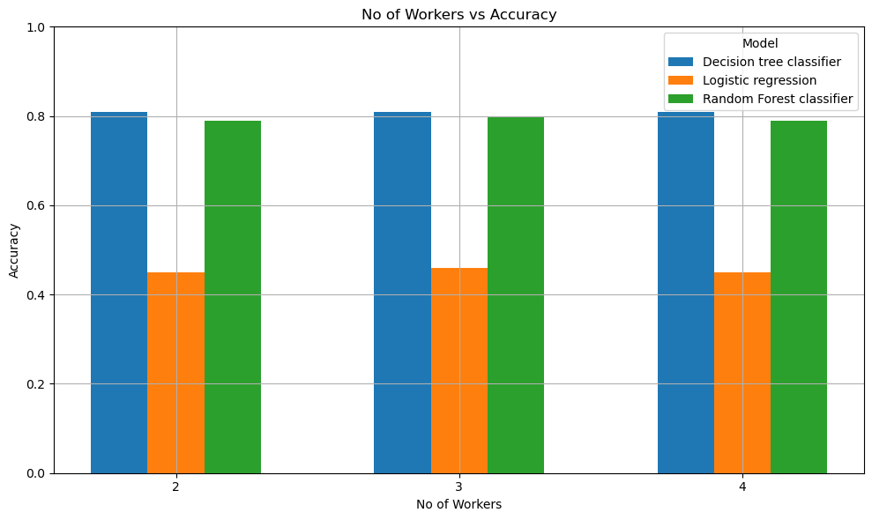
Scaling Out

Slide 28
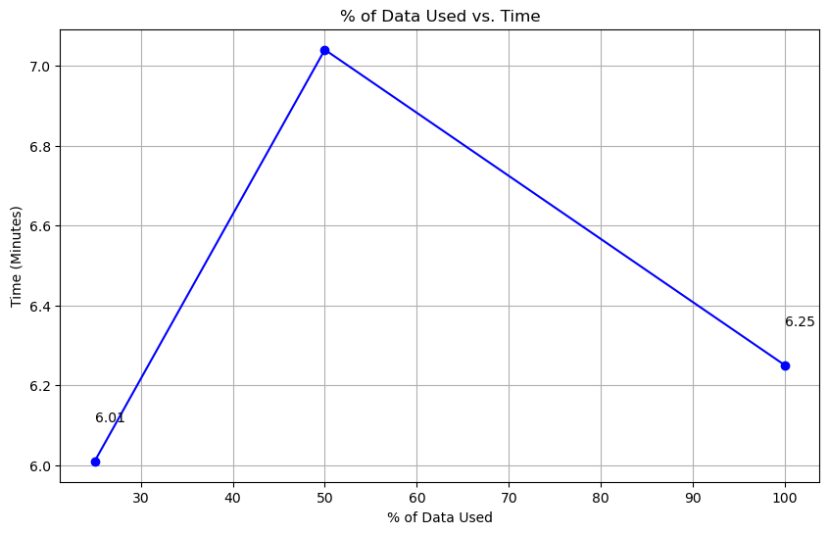
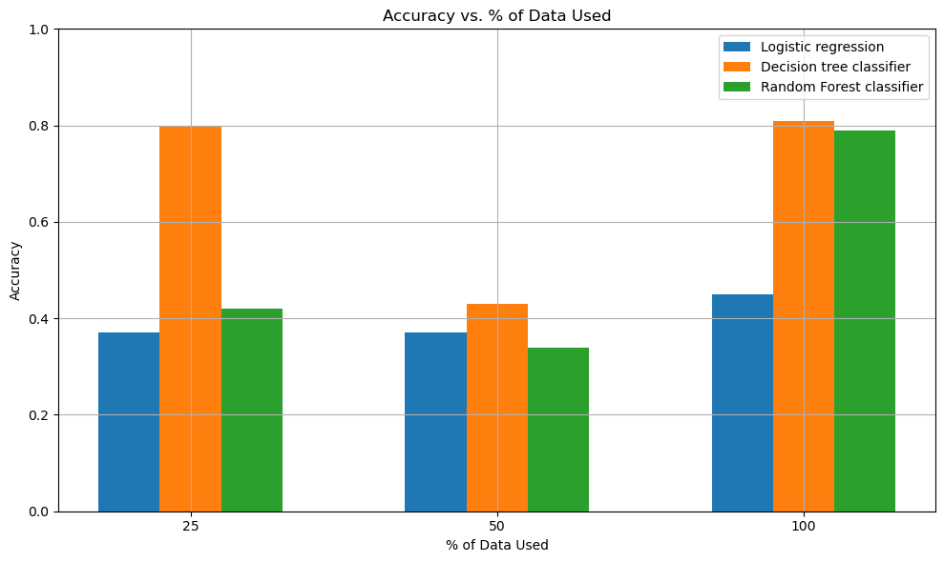
Scaling Up

Slide 29

Price Forecasting
Main objective is to forecast the Price.
Models
Features:
Pickup Latitude
Pickup Longitude
Year
Month
Day
Hour
Minute
Distance
Duration
Speed
Temperature
Holiday
Passenger Count
Demand Category
Demand Category Square
Target:
Price
Linear Regression
Random Forest

Slide 30
Model Evaluation
Model | R-Squared Score | RMSE
Linear Regression | 0.92 | 3.83
Random Forest Regressor | 0.89 | 4.46
To optimize the Random Forest Regressor, hyperparameter tuning was conducted.
Model | Trees | Depth | R-Squared Score | RMSE
Random Forest Regressor | 20 | 10 | 0.92 | 3.831

Slide 31
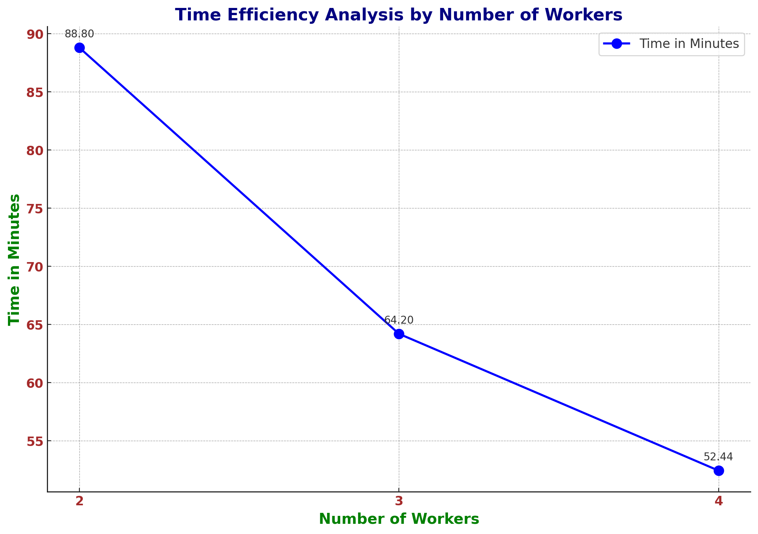
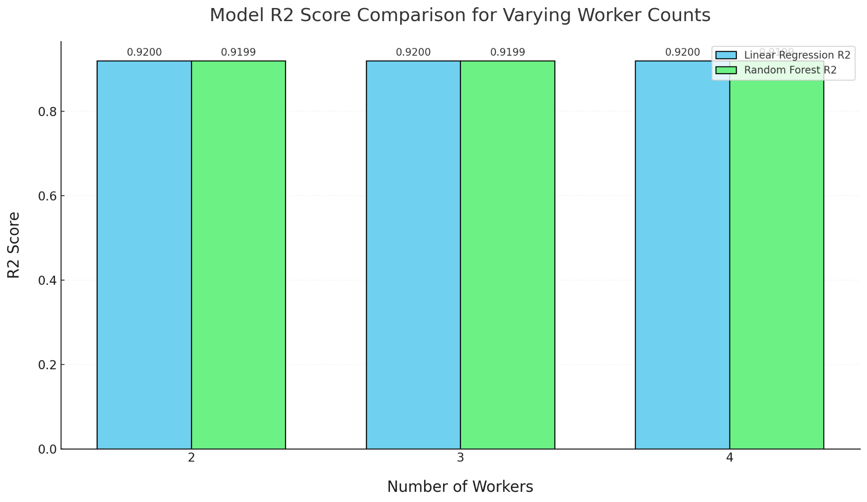
Scaling Out

Slide 32
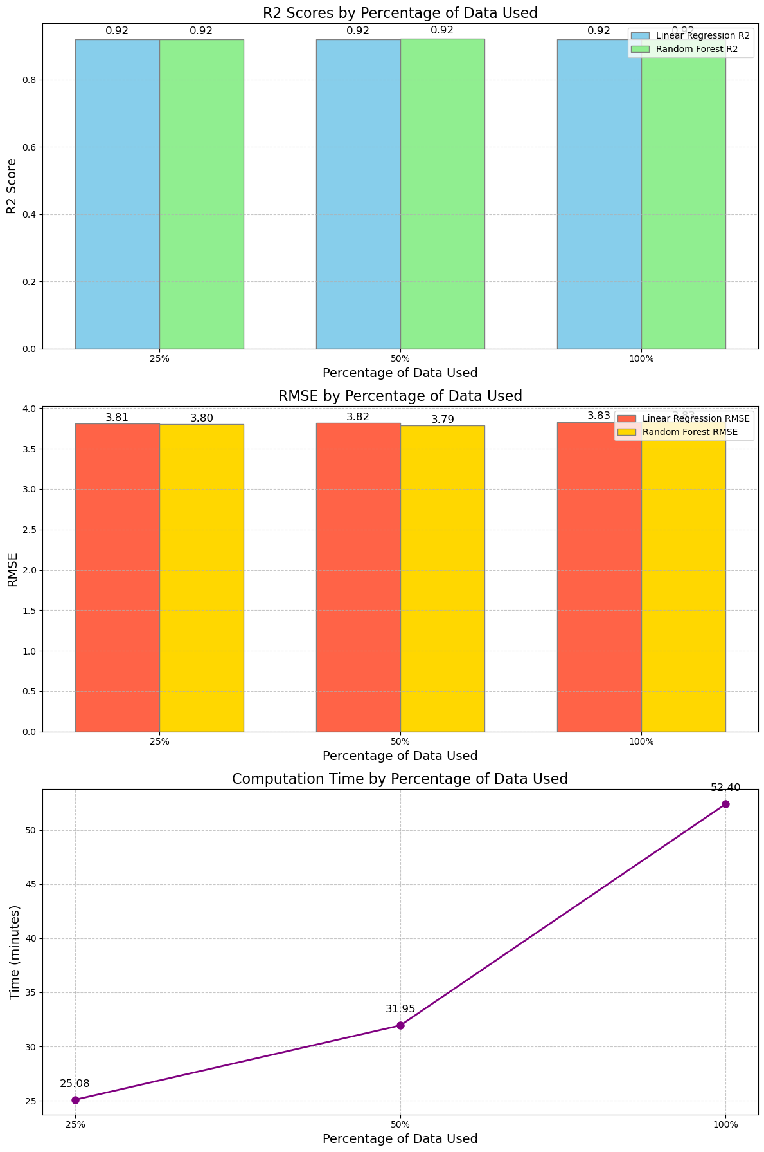
Scaling Up

Slide 33
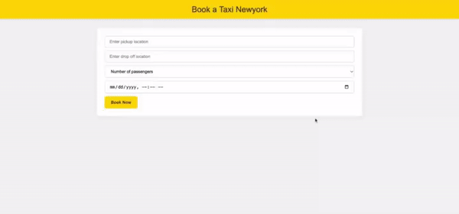
Deployment

Slide 34


